Slide 1







EagleSat 2
Becca Laub – Project Manager
Embry-Riddle Aeronautical University Arizona Space Grant Consortium Symposium
April 18th, 2020

Slide 2
Outline
Project Overview
Major Setbacks and Issues
Major Successes
Future Progress

Slide 3
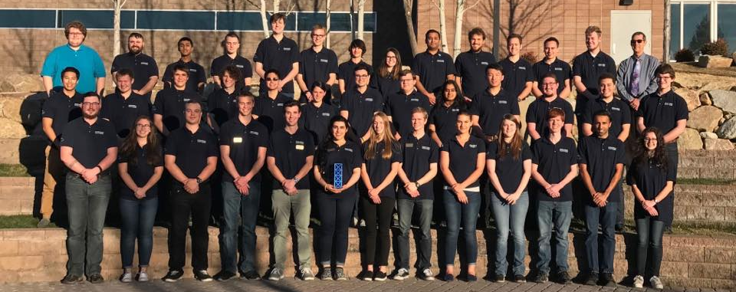
Purpose and Benefits
Education
Strong, achievable scientific goals
Commercially available bus systems
Work with teams, departments, and organizations both on and off campus

Slide 4
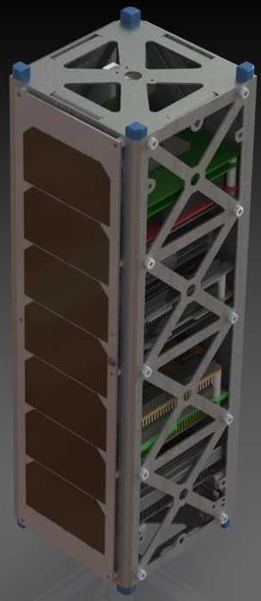
Mission Overview
Scientific Goals
Memory degradation experiment (MDE)
Cosmic Ray Payload (CRP)
Spacecraft – 3U CubeSat
SELECTED - 2018 NASA CubeSat Launch Initiative
Designing for ISS orbit
402-424 km
51.6 degree inclination
Current launch date- April 2021

Slide 5
Major Issues for 2019-2020
Money constraints
OBC Changes
ACS Board
Apocalypse

Slide 6
Major Successes for 2019-2020
Got launch opportunity – Fall 2020 with July 2020 turnover
Finished major development milestones on subsystems
Learned many things about developmental roadblocks
Started fabrication of in house systems

Slide 7
Plans for Next Year
Finish Payloads
Finish OBC
Battery testing
V & V
Launch
Continue ES3 work

Slide 8
EagleSat 2
Questions?

